Slide 1
Automated SKU Mapping and New SKU Proposal for Fertilizer Company: Leveraging Machine Learning for Efficient Product Catalog Management

Slide 2
Team Introduction

Slide 3
Data & Methodology

Slide 4
Datasets Overview
Product Catalog Dataset:
Contains information about different products, including their stock keeping units (SKUs), brand, type, and formula.
Columns: Product SKU, Brand, Type, Formula.
Product Name from POS Transactions Dataset:
Contains product names as they appear in Point of Sale (POS) transactions, often in free-text form.
Column: Product Name.

Slide 5
Steps in Analysis and Problem Solving (1)
Data Loading and Exploration:
Loaded both datasets to understand their structure.
Used pandas in Python for data handling.
Data Preprocessing:
Handled missing values and normalized text data for consistency.
Performed operations like lowercasing and dropping null values.

Slide 6
Steps in Analysis and Problem Solving (2)
Mapping POS Transaction Names to Product SKUs:
Employed text similarity algorithms (TF-IDF and cosine similarity) to map POS transaction product names to SKUs.
Used Python's scikit-learn library for these computations.
Analysis and Reporting:
Conducted basic statistical analysis to understand product and brand popularity.
Generated visualizations (bar charts, word clouds) for a clearer understanding of product distribution and keyword prevalence.
Tools used: Matplotlib and Seaborn for visualization, WordCloud for text analysis.

Slide 7
Steps in Analysis and Problem Solving (3)
Advanced Data Analysis:
Explored deeper insights with correlation analysis between categorical data and keyword analysis in product names.
Encountered challenges in calculating correlation due to the nature of categorical data.
Building a Predictive Model:
Proposed the creation of a machine learning model to predict SKUs from product names.
Recommended steps included vectorization of text, encoding SKUs, model training (Random Forest Classifier), and evaluation.
Encountered computational limitations in the execution environment.

Slide 8
Tools Used
Python Programming Language: Primary tool for data handling, processing, and analysis.
Pandas: For data manipulation and analysis.
Scikit-learn: For machine learning tasks like TF-IDF vectorization, model building, and evaluation.
Matplotlib and Seaborn: For data visualization.
WordCloud: For generating word clouds in keyword analysis.

Slide 9
Result

Slide 10
Metrics
Similarity Scores: Used to quantify the closeness between POS transaction product names and product SKUs. The distribution of these scores guided the decision-making in mapping products to SKUs and identifying potentially unmatched products.
Frequency Counts: In product and brand popularity analysis, frequency counts helped identify the most common SKUs and brands in POS transactions.
Unique SKU Count: The number of unique SKUs mapped in the POS transactions dataset provided a measure of the diversity and range of products handled.

Slide 11
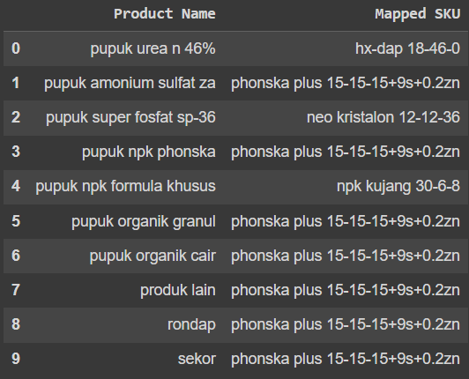
Essential Findings from the Analysis (1)
Mapping Accuracy and Coverage:
Utilizing TF-IDF vectorization and cosine similarity algorithms, we were able to map the majority of product names from POS transactions to existing SKUs in the product catalog.
This approach significantly streamlined the process of identifying and categorizing products based on their transactional names.

Slide 12
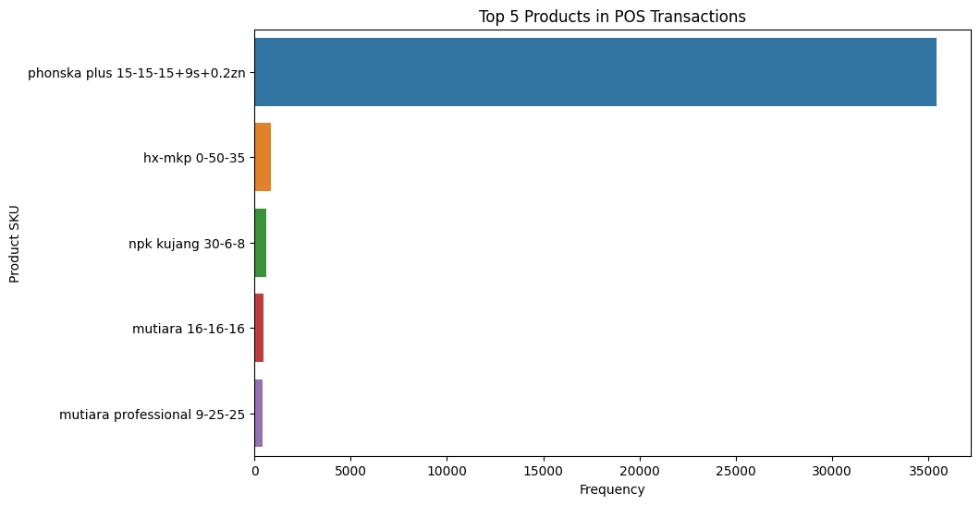
Essential Findings from the Analysis (2)
Product and Brand Popularity:
Analysis revealed that certain SKUs and brands were significantly more prevalent in POS transactions, indicating higher popularity or demand. For instance, "phonska plus 15-15-15+9s+0.2zn" emerged as the most frequent SKU.
The most prevalent brands included PIHC and Pak Tani, suggesting their strong market presence or customer preference.

Slide 13
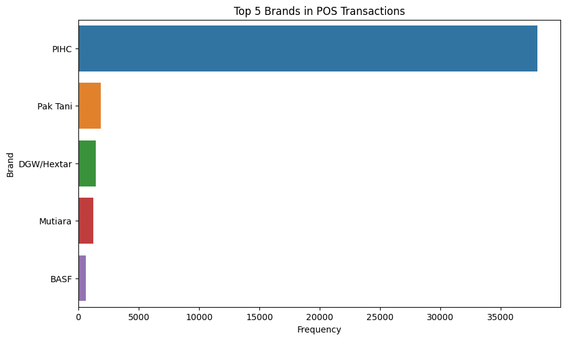
Essential Findings from the Analysis (3)
Product and Brand Popularity:
Analysis revealed that certain SKUs and brands were significantly more prevalent in POS transactions, indicating higher popularity or demand. For instance, "phonska plus 15-15-15+9s+0.2zn" emerged as the most frequent SKU.
The most prevalent brands included PIHC and Pak Tani, suggesting their strong market presence or customer preference.

Slide 14
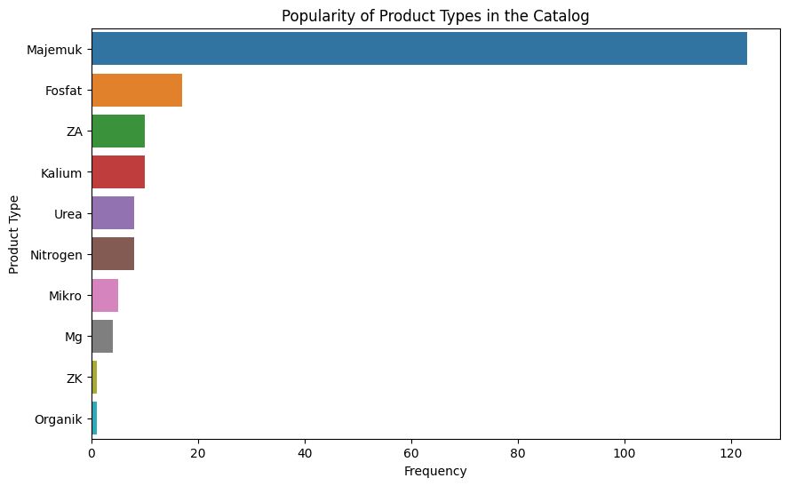
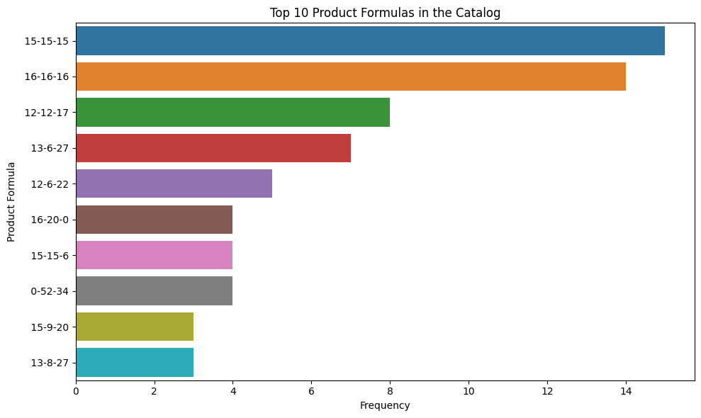
Essential Findings from the Analysis (4)
Product Type and Formula Distribution:
The product catalog comprised a diverse range of product types and formulas, with "Majemuk" being the most common product type and formulas like "15-15-15" and "16-16-16" appearing frequently.

Slide 15
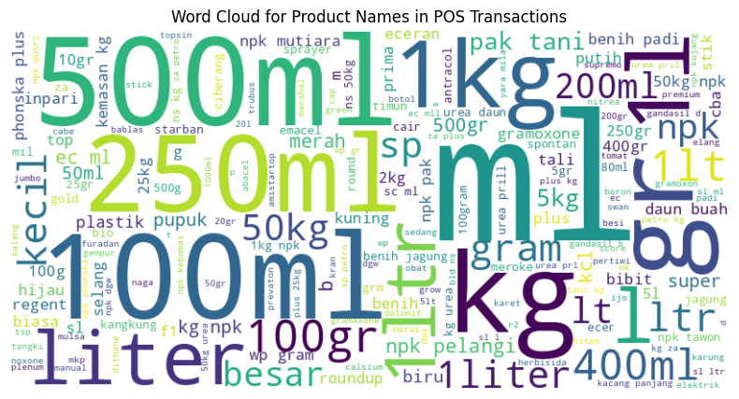
Essential Findings from the Analysis (5)
Keyword Analysis:
A word cloud generated from product names in POS transactions highlighted key words and phrases commonly used. This analysis provided insights into the features or attributes most emphasized in product names, reflecting market trends and customer preferences.

Slide 16
Machine Learning Model
 | Validation | Evaluation
Accuracy |  | 0.99
Precision |  | 0.89
Recall |  | 0.85
F1-Score |  | 0.86

Slide 17
Conclusion

Slide 18
Analysis Summary (1)
SKU Mapping and Data Consistency:
Successfully mapped free-text product names from POS transactions to standardized SKUs in the product catalog using text similarity algorithms.
Enhanced data consistency and streamlined the catalog management process.
Product and Brand Insights:
Revealed key insights into product popularity and brand prevalence in POS transactions.
Identified top products and brands, offering valuable information for inventory planning and marketing strategies.

Slide 19
Analysis Summary (2)
Keyword and Content Analysis:
Conducted keyword analysis to extract prevalent themes and attributes in product names, providing insights into market trends and customer preferences.
Diverse Product Range:
Analyzed the variety in product types and formulas within the catalog, highlighting the range of offerings and potential areas for expansion or focus.

Slide 20
Proposed Solutions for Raised Issues (1)
Automated SKU Mapping Model:
Proposed building a machine learning model to predict SKUs from product names in POS transactions automatically. This model could significantly reduce manual effort and improve efficiency in product catalog management.
Suggested steps included data preparation, model training (using algorithms like Random Forest Classifier), and evaluation.
New SKU Proposal Mechanism:
For products with low similarity scores (indicating no clear match in the catalog), suggested a mechanism to propose new SKUs, ensuring that all products are accounted for and appropriately classified.

Slide 21
Proposed Solutions for Raised Issues (2)
Advanced Analytical Techniques:
Recommended deeper analytical approaches like correlation analysis between product attributes and cluster analysis for market segmentation, providing a more nuanced understanding of the data and customer behavior.
Enhanced Data Visualization:
Utilized data visualization tools to present key findings effectively, aiding in easier interpretation and decision-making.

Slide 22
Overall Solution Impact
The proposed solutions aimed to tackle the challenges of managing a diverse and extensive product catalog, especially when dealing with inconsistent product naming conventions in POS transactions. By leveraging machine learning for automated SKU mapping and proposing a new SKU generation system, the solutions provided a pathway to more efficient and accurate catalog management. The insights from various analyses offered actionable intelligence for strategic business decisions, enhancing overall operational efficiency and market responsiveness.

